Slide 1
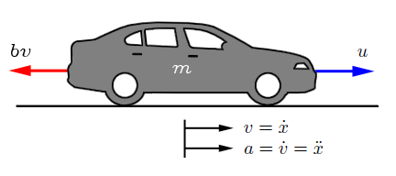

DEVELOP A VEHICLE DYNAMICS MODEL
In order to model vehicle dynamics, we draw a free body diagram to the vehicle.
The vehicle of mass m is acted upon by a control force u. The force u represents the force generated at the road/tire interface.
The resistive forces $bv$ due to rolling resistance and wind drag, are changing in a linear form with the velocity and act in an opposite direction to the vehicle.
http://ctms.engin.umich.edu/CTMS/index.php?example=CruiseControl&section=ControlPID

Slide 2

DEVELOP A VEHICLE DYNAMICS MODEL
By applying newton’s second law of motion:
$$m\ddot{x}=u−bv$$
Getting the transfer function as before:
$$mSV(s)=U(s)−bV(s)$$
Getting the output/input
$$\left(mS+b\right)V\left(s\right)=U(s)$$
Therefore
$$V\left(s\right)/U(s)=1/\left(mS+b\right)$$
http://ctms.engin.umich.edu/CTMS/index.php?example=CruiseControl&section=ControlPID

Slide 3
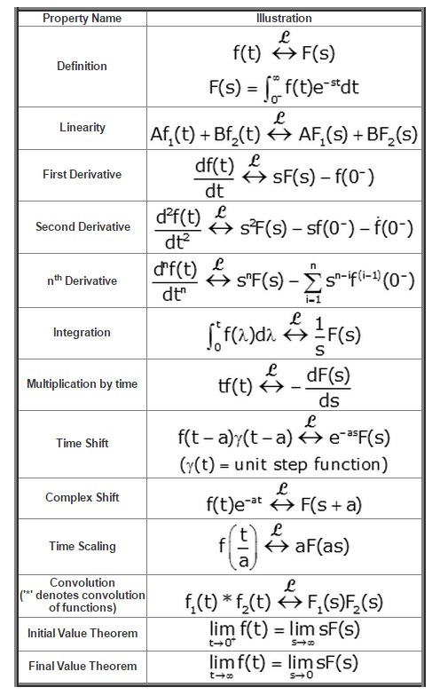
DEVELOP A VEHICLE DYNAMICS MODEL: LAPLACE TRANSOFRM

Slide 4
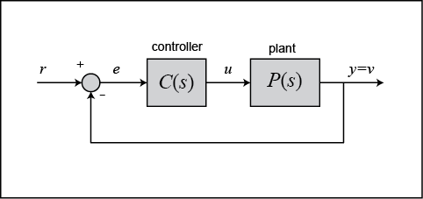

DEVELOP A VEHICLE DYNAMICS MODEL: PID CONTROLLER

Slide 5
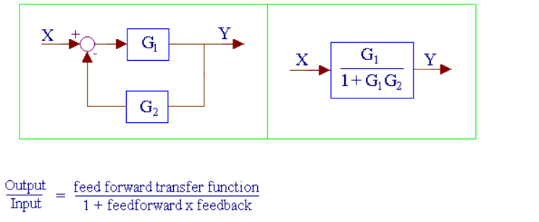
DEVELOP A VEHICLE DYNAMICS MODEL: MODEL REDUCTION
http://www.msubbu.in/sp/ctrl/BD-Rules.htm

Slide 6



DEVELOP A VEHICLE DYNAMICS MODEL: MODEL REDUCTION
$K_{p}+\frac{K_{i}}{s}+K_{d}s=\frac{K_{d}s^{2}+K_{p}s+K_{i}}{s}$
$$V\left(s\right)/U(s)=1/\left(mS+b\right)$$
$\frac{K_{d}s^{2}+K_{p}s+K_{i}}{\left(m+K_{d}\right)s^{2}+\left(b+K_{p}\right)s+K_{i}}$

Slide 7
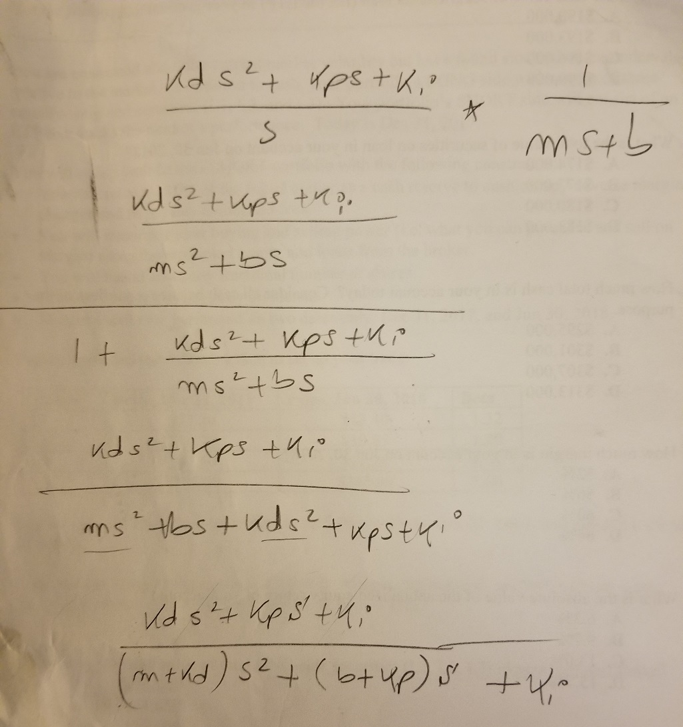

DEVELOP A VEHICLE DYNAMICS MODEL: MODEL REDUCTION
$\frac{K_{d}s^{2}+K_{p}s+K_{i}}{\left(m+K_{d}\right)s^{2}+\left(b+K_{p}\right)s+K_{i}}$

Slide 8


DEVELOP A VEHICLE DYNAMICS MODEL: ASSUME P- CONTROLER ONLY
$\frac{K_{d}s^{2}+K_{p}s+K_{i}}{\left(m+K_{d}\right)s^{2}+\left(b+K_{p}\right)s+K_{i}}$
$\frac{K_{p}s}{\left(m\right)s^{2}+\left(b+K_{p}\right)s}$

Slide 9
DEVELOP A VEHICLE DYNAMICS MODEL: MODEL REDUCTION
$K_{p}+\frac{K_{i}}{s}+K_{d}s=\frac{K_{d}s^{2}+K_{p}s+K_{i}}{s}$
$$V\left(s\right)/U(s)=1/\left(mS+b\right)$$

Slide 10
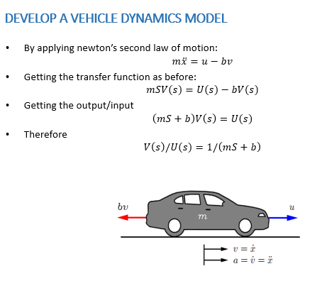
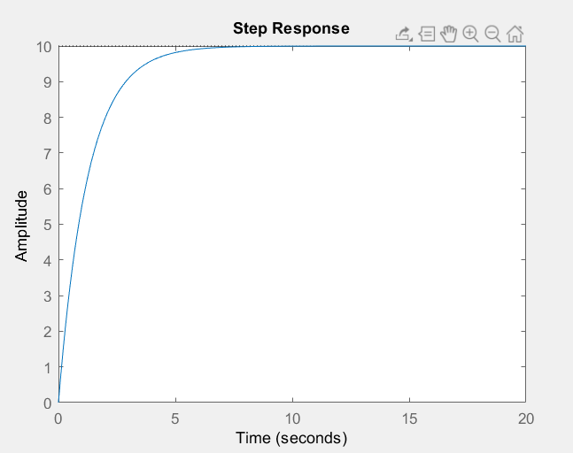
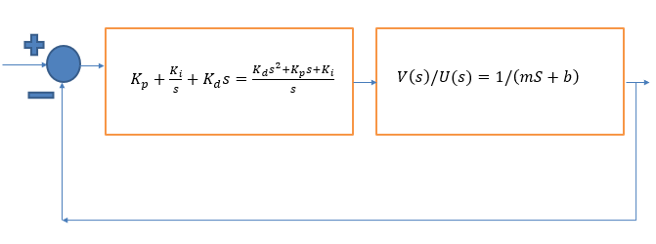
ADAPTIVE CRUISE CONTROL

